Slide 1



Business Analysis Project
Vrinda Store Annual Report 2022
Vrinda Store
By - Radhika Jha

Slide 2
Business Problem
Compare sales & orders using single chart
2.Which month got the highest sales & orders ?
3.Who purchased more men or women in 2022?
4. What are different order status in 2022?
5.List top 10 states contributing to sales?
6.Relation between age & gender based on number
7. Which channel is contributing to maximum sales?
8.Highest selling category?

Slide 3
Steps
Anaylse Business Problem
Data Cleaning
Data Analysis
Data Visualization
Report
Insights

Slide 4
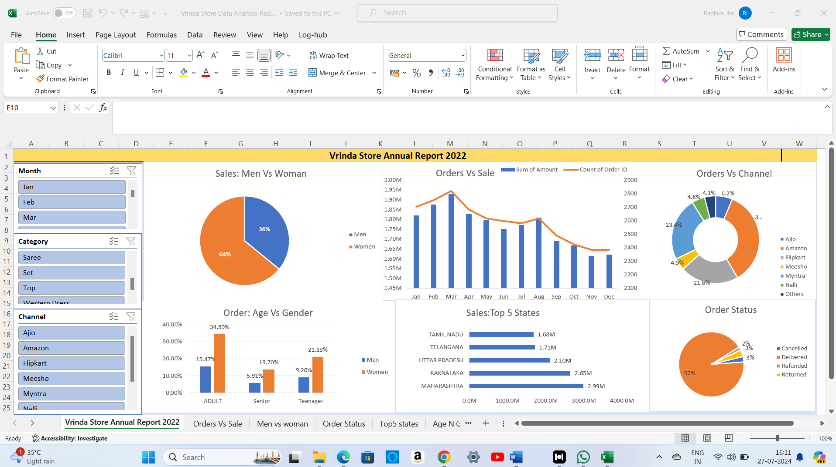
DashBoard

Slide 5
Insights
Women are more likely to buy compared to men (65%)
Maharashtra,Karnataka and Uttar Pradesh are top 3 states(35%)
Adult age group (30-49 yrs) is max contributing(50%)
Amazon,Flipkart and Myntra channels are max contributing (80%)

Slide 6

Conclusion
To Improve Vrinda Store Sales
Target women customers of age group (30-49 yrs)living in Maharashtra,Karnataka and Uttar Pradesh by showing ad/coupon/offers available on Amazon,Flipkart and Myntra

